Slide 1
DAIS Initial Program Plan
Forging Scientific Collaboration September 2016 to January 2018

Slide 2
A flagship program
DAIS-ITA is a collaborative partnership between the U.S. Army and the UK Ministry of Defence brings together researchers from
U.S. Army Research Laboratories
UK Defence Science & Technology Laboratory
A consortium of universities & industrial research laboratories in U.S. and UK.
The goal of the alliance is to foster collaborative fundamental research in both nations that will to enable secure dynamic semantically aware distributed analytics for situational understanding in coalition operations.
The members of the alliance seek to break down barriers, build relationships, develop mutual understanding and work in partnership to develop technology for the U.S. and UK military.

Slide 3
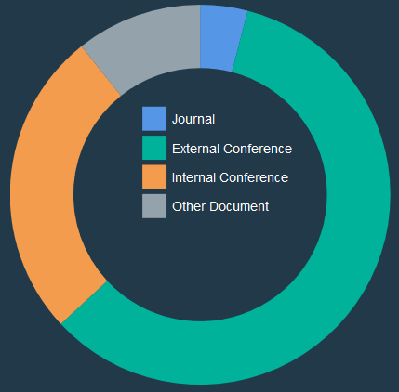
Strong publication record
Publication Type | Count
Journal | 6
External Conference | 88
Total External | 94
Internal Conference | 39
Other Document | 16
Grand Total | 149
4 best paper/poster awards from peer reviewed external venues
Publications in top conferences including SIGCOMM, ICDCS, ICNP, and NIPS

Slide 4
Focus on collaborative research
Publication Authors | Count
International | 101
Same country | 31
Total Collaborative | 132
Single Institute | 17
Grand Total | 149
90% of publications are collaborative with co-authors from multiple member organizations, 68% having international collaborators
36% of all publications include a government co-author

Slide 5
Collaboration across disciplines
 | P1 | P2 | P3 | P4 | P5 | P6
P1: Software Defined Coalitions (SDC) | x | x
P2: Generative Policy Models for Coalitions | x | x | x | x | x | x
P3: Agile Composition for Coalition Environnements |  | x | x |  | x
P4: Evolution of Complex Adaptive Human Systems |  | x |  | x |  | x
P5: Instinctive Analytics in a Coalition Environment |  | x | x |  | x | x
P6: Anticipatory Situational Understanding for Coalitions |  | x |  | x | x | x
Cross project collaborations yielded 11 external publications during the IPP

Slide 6
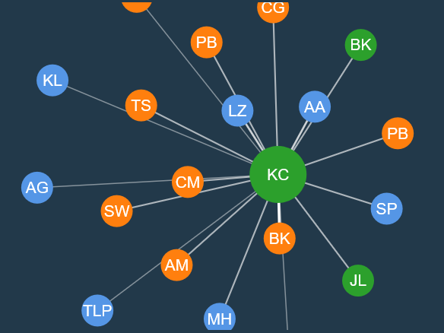
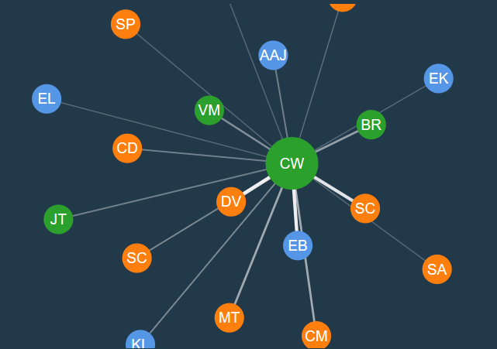
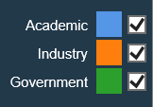
Diverse working relationships
Co-authors of Kevin Chan from ARL
Co-authors of Chris Williams from Dstl
Researchers collaborating and co-authoring across the consortium
32% of external publications include a government co-author

Slide 7
The DAIS ITA Science Library contains all currently published publications, authors and organizations involved. Link: http://sl.dais-ita.org/science-library

